Slide 1


Chapter 7
Physical Reliability Models
Periodic Loads
Random Loads
Physics of Failure
Reliability just has to be my favorite subject!
Chapter 7
Notes:
Often stresses occur either periodically or randomly over time. When this happens, the static reliability can be converted to a dynamic reliability.

Slide 2
Periodic Loads
X_{i} , Y_{i} = the load and strength observed on the ith cycle
After n cycles, the reliability, R_{n} is found from
R_{n} = P(X₁<Y₁, X₂<Y₂, .. . , X_{n}<Y_{n} )
= P(X₁<Y₁) P(X₂<Y₂) ... P(X_{n}<Y_{n})
assuming independent load and strength applications each cycle.
Since Pr{X_{i} < Y_{i}} = R, then R_{n} = R^{n}
Building in Baltimore surviving 10 years: R(10) = .98214¹⁰ = .8351
Chapter 7
Notes:
If periodic loads are placed upon a component, each occurrence could potentially result in a failure. Therefore the reliability over n occurrences is the probability that the component survives each load. An important assumption is that the static reliability does not change over time (the stress and strength distributions are stationary).

Slide 3
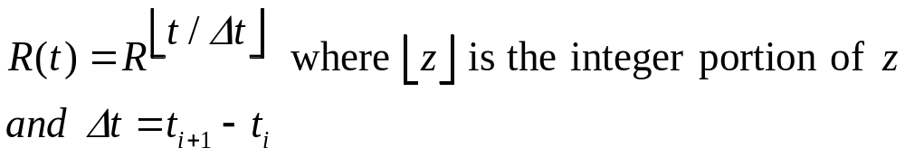
Periodic Loads
R(t) = R^{n} for t_{n} <= t < t_{n+1}
With t₀ = 0 and uniformly spaced load times,
Chapter 7
Notes:
If loads occur at equal time intervals, then R(t) can be defined based by determining the number of occurrences in time t.

Slide 4
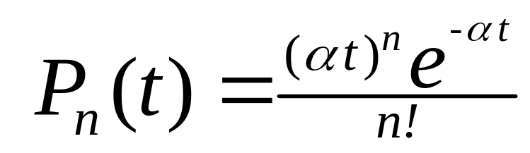

Random Loads
Let N = a RV, the number of loads per unit of time.
Then the probability of n loads in time t is given by:
a Poisson
process
where is the mean number of loads per unit of time.
Chapter 7
Notes:
Assuming loads occur at random based upon a Poisson process, then the probability of n stresses occurring in time t is found using the above probability mass function.

Slide 5
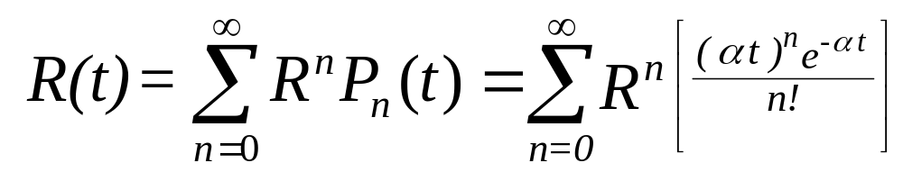
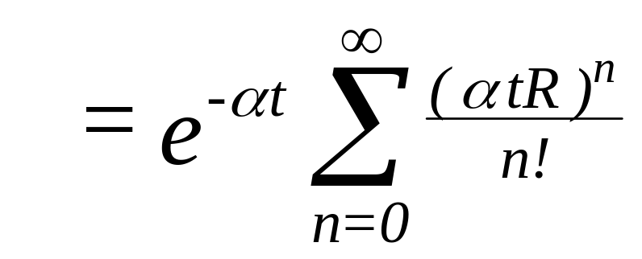
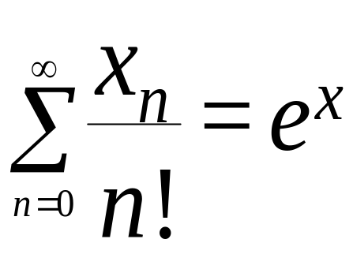
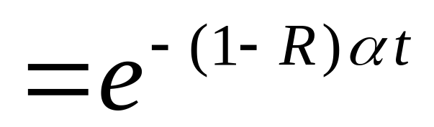
Random Loads
using
Chapter 7
Animated
Notes:
The reliability at time t is the sum over all possible number of stresses n of R^{n} times the probability of n stresses occurring. The result is just another form of the exponential failure distribution where (1-R) α is the failure rate (probability of a failure times the mean number of occurrences).

Slide 6
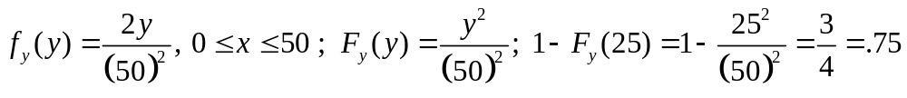
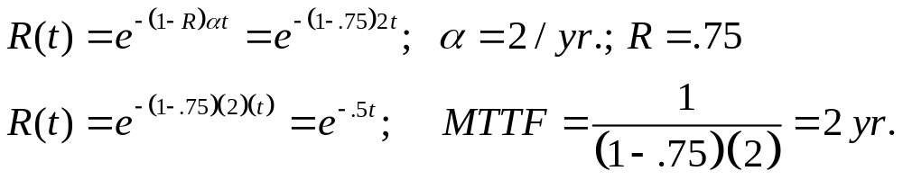
Dynamic Models - Example
A critical component manufactured by the Stress n’Strength Company has a random design strength and will be subjected to a fixed stress of 25 psi .
The component is replaced at the mean rate of once every 6 months, Poisson distributed.
Chapter 7

Slide 7
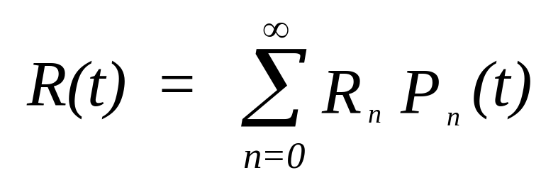
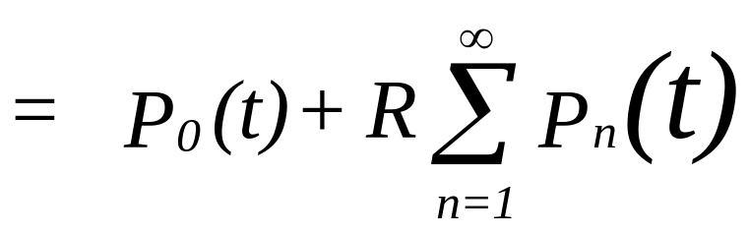
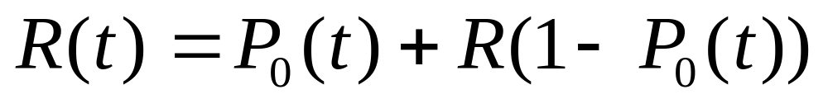
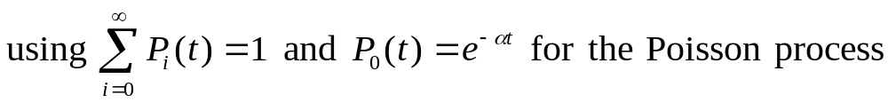
Random Fixed Stress and Strength
since R₀ =1 and R_{n} = R = Pr{x < y}
Chapter 7
Notes:
A different type of random case occurs when both the load and design strength are initially set and then remain fixed for each subsequent occurrence. The case shown above assumes random (Poisson) loads. R(t) can be interpreted as the probability stress < strength (R) plus the probability the stress >= strength times the probability of loads being applied (P₀). Otherwise the first load (when stress >= strength) will result in a failure. Can you think of an example that fits situation?

Slide 8
Example 7.17
A single emergency shut-off valve has an exponentially
distributed strength having a mean of 3700 lb. The force,
or load, is also exponentially distributed with a mean of
740 lb. Once applied, the load will remain constant.
Emergency shutoff procedures occur randomly at the rate
of 1 per yr.
R = 1/(1+740/3700) = .83
R(t) = .83 + .17 e^{-t}
R(1) = .8925
Animated
Chapter 7
Notes:
Why here is an example!

Slide 9
Physics of Failure (POF)
An approach to reliability which utilizes knowledge of
the failure mechanisms to prevent failures through
robust design and manufacturing practices.
POF models are derived for each failure mode from
design information, experimental data, engineering
analysis, and physical and chemical laws.
To date, a relatively small number of parts have been
addressed with POF models.
Chapter 7
Notes:
An alternate approach to account for the physical characteristics of the failure process, is referred to as physics of failure. This method attempts to capture in a mathematical model the failure process itself by applying fundamental science and engineering relationships often at the molecular level.

Slide 10
More Physics of Failure (POF)
Basic premise - failure processes follow physical (or
chemical or metallurgical) laws that can be modeled
and the amount of life available for exposure to a
given stress condition can then be calculated. From
this a failure free operating period is determined.
POF are physically based rather than statistically based!
Chapter 7
Notes:
Detailed knowledge of the physics and chemistry of the failure process is necessary to apply this method.

Slide 11
Even More Physics of Failure (POF)
The Process
Identify failure mechanisms, failure sites, and failure modes.
Determine appropriate failure models and their input parameters.
  Material characteristics
  damage properties
  failure site geometry
  manufacturing flaws and defects
  environment and operating loads
Determine variability of each design parameter.
Compute an effective reliability function
Chapter 7
Notes:
An easy four-step approach to implementing the physics of failure process.

Slide 12
Failures can be defined by the failure mode, failure site, and failure mechanism
Failure mode is an observable change caused by a failure
mechanism. Examples are opens, shorts, leaks, and
excessive noise or vibration.
Failure sites are the specific locations and geometry at which
the failure mechanism interacts with the material.
Failure mechanisms are physical (or chemical) processes
by which stresses damage the material at the failure site.
Chapter 7
Notes:
These concepts will be useful later as well when Failure Mode and Effect Analysis (FMEA) is discussed.

Slide 13

Stresses trigger the failure mechanism
Mechanical
thermal
electrical
radiation
chemical
biological
combinations
Chapter 7
Notes:
High level processes that generate failures.

Slide 14

Examples of Failure Mechanisms
Wearout
  fatigue
  friction
  corrosion
  creep
  electromigration
  contamination
  molecular migration
  temperature cycling
Overstress
  dielectric breakdown
  fracture
  buckling
  thermal breakdown
  electrical overstress
Chapter 7
Notes:
Examples of failure mechanisms. Can you name some others?

Slide 15
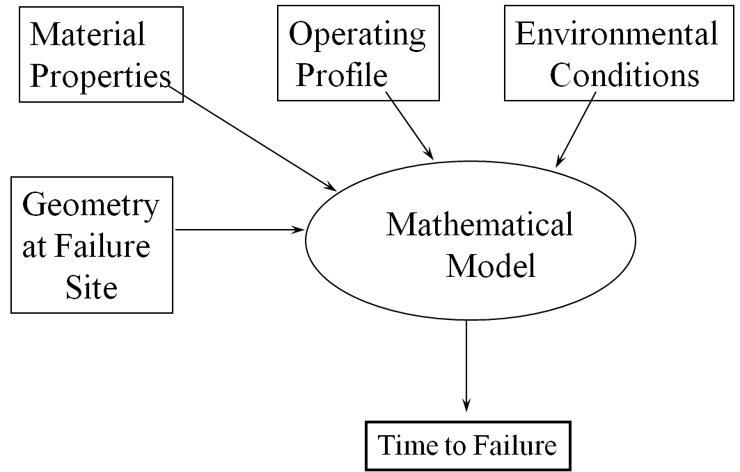
Physics of Failure
Chapter 7
Notes:
A high level look at the physics of failure (POF) concept.

Slide 16
Model Accuracy
accuracy of the material failure or damage model
accuracy of the corresponding stress analysis (environment)
the accuracy of the empirical data (geometry at the failure site and material property characteristics)
Chapter 7
Notes:
Where can we go wrong in this process?

Slide 17

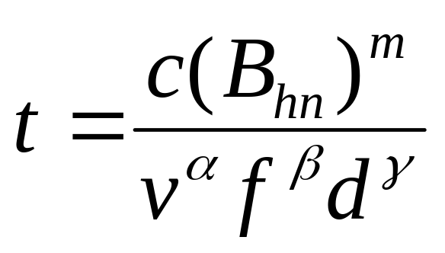

Example 7.19
where t = the life of a tool in minutes,
B_{hn} = the Brinell hardness number of the work material
v = cutting speed in feet per minute
f = the feed in inches per revolution or inches per saw tooth
d = depth of the cut in inches
c, m, and are empirical constants.
Chapter 7
Notes:
An early example that is in the spirit of the POF process.

Slide 18
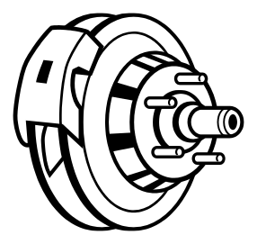
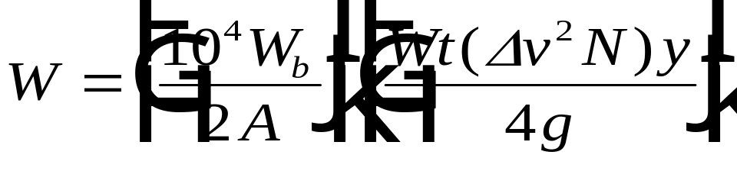

Example 7.20
W = pad wear per mile in inches
W_{b} = specific wear rate of friction material (in³ /ft-lbf)
A = lining area, in²
v = average change in velocity per brake action, ft/sec
Wt = weight of vehicle
g = acceleration due to gravity, 32.2 ft/sec²
N = frequency of brake applications per mile
y = proportion of total braking effort transmitted through the lining
Pad Life = d (pad thickness) / W in miles
Chapter 7
Notes:
Another example that attempts to model the physical process.

Slide 19

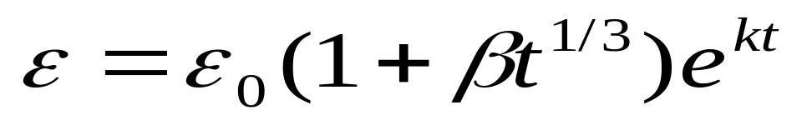
Example 7.21
ε = the strain at time t,
ε₀ = the initial elastic strain, and
β , k are constants depending upon the particular material.
If ε_{max} is the fracture stress of the material, then setting ε = ε_{max}
in the above formula and solving for t provides the design life
with respect to creep (progressive deformation of the material).
Chapter 7
Notes:
Although this model is more empirically than physically derived, it does capture mathematically the process that can lead to failure.

Slide 20
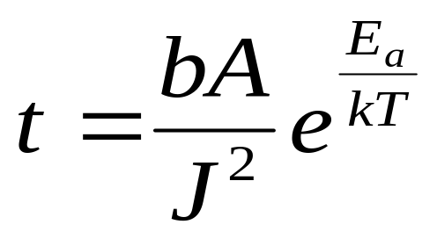
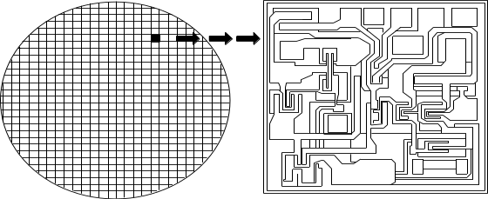
Example 7.22- Electromigration failures
t = mean time to failure in hours
b = empirically derived constant
(2.85 x 1015 for an aluminum conductor)
A = cross-sectional area of the conductor in cm2
J = current density in amp/cm2
E_{a} = activation energy in eV
k = Boltzman’s constant (8.62 x 10-5 eV/degree K.)
T = temperature in degrees Kelvin
Chapter 7
Notes:
Electromigration failures have been a useful area for study within the POF process.

Slide 21
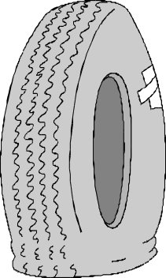
Wear Due to Friction
.
adhesive wear - fragments are pulled from one surface and adhere to the other. Loose particles may also be produced.
abrasive wear - occurs when a hard surface slides over a softer surface generating a series of grooves in the softer material along with loose particles.
corrosive wear - sliding surfaces chemically react with the the partner surface or the environment, or both.
surface fatigue - is generated when cycling loading produces cracks which break up the surface. Ball bearings, wheels on rails, and gears are susceptible to surface fatigue.
Wear due to friction can be reduced with the proper
choice of materials and lubrication
Chapter 7
Notes:
When modeling failure due to friction, the different types of friction must be considered.

Slide 22
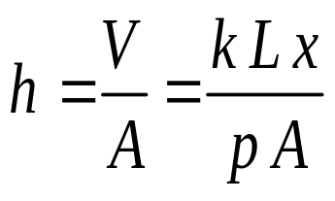
Law of adhesive wear
Amount of wear is directly proportional to the load, L and distance slid x,
and inversely proportional to the hardness, p, of the surface being worn
away. That is V = k L x / p
where V = volume worn away in mm³
k = nondimensional wear coefficient determined experimentally
and dependent upon the materials in contact and the lubricant if present,
L = load in kg
x = sliding distance in mm
p = hardness in kg/mm² (an indenter force divided by the projected
area of the indent)
If A = surface area in contact in mm² then
is the average depth of the material worn away in mm.
Chapter 7
Notes:
For adhesive wear, the above relationship between load and wear can be used to derive a time to failure model based upon a failure occurring when the linear wear, h, reaches a maximum value. To convert this into a time to failure, the rate of the friction over time must also be known.

Slide 23

Chapter 7 Summary
Covariate Models
Static & Dynamic Models
Physics of Failure Models
They sure are! However, I am anxious to begin the next chapter to learn about other exciting reliability concepts.
These are some really great models.
Chapter 7
Notes:
You should now work the assigned Chapter 7 problems if you have not already done so.

